Slide 1

Summer School
“Working in Command Line +
Biological Problem Hunt”
Dr. Tarang K. Mehta and Dr. George Kettleborough

Slide 2
Schedule
9.00-9.15am: Bioinformatics/Unix/Linux Intro
9.15-9.30am: Terminal/Command Line Intro
9.30-10.15am: Command Line Familiarity
10.15-10.30am: Mini Project Intro
10.30-11.00am: BREAK
11.00-12.30pm: Biological Problem Hunt

Slide 3


Slide 4



Bioinformatics operating systems
Bioinformatics rarely done on Windows systems, both for historical and utility reasons
Most people prefer to work on “Unix­like” operating systems, like Linux or MacOS
We are going to see how to use them and which are the advantages

Slide 5

Unix
Unix is the name of an operating system developed in the '80s
It quickly became the most adopted system in the academic world, and its descendant are still the most common in the academia nowadays

Slide 6
Innovations introduced by Unix
A novel approach to organizing files and scripts
Good philosophy for data analysis
Still used nowadays for bioinformatics & programming
Free License for universities and companies

Slide 7
Unix vs Linux
The original Unix system doesn't work on a recent computer
Linux is a free and modern re­implementation, with a user­friendly interface and support
Rather than being different, one is the ancestor of the other

Slide 8
Linux: Hands-on
Log-in to NoMachine
IP
Username
Password

Slide 9
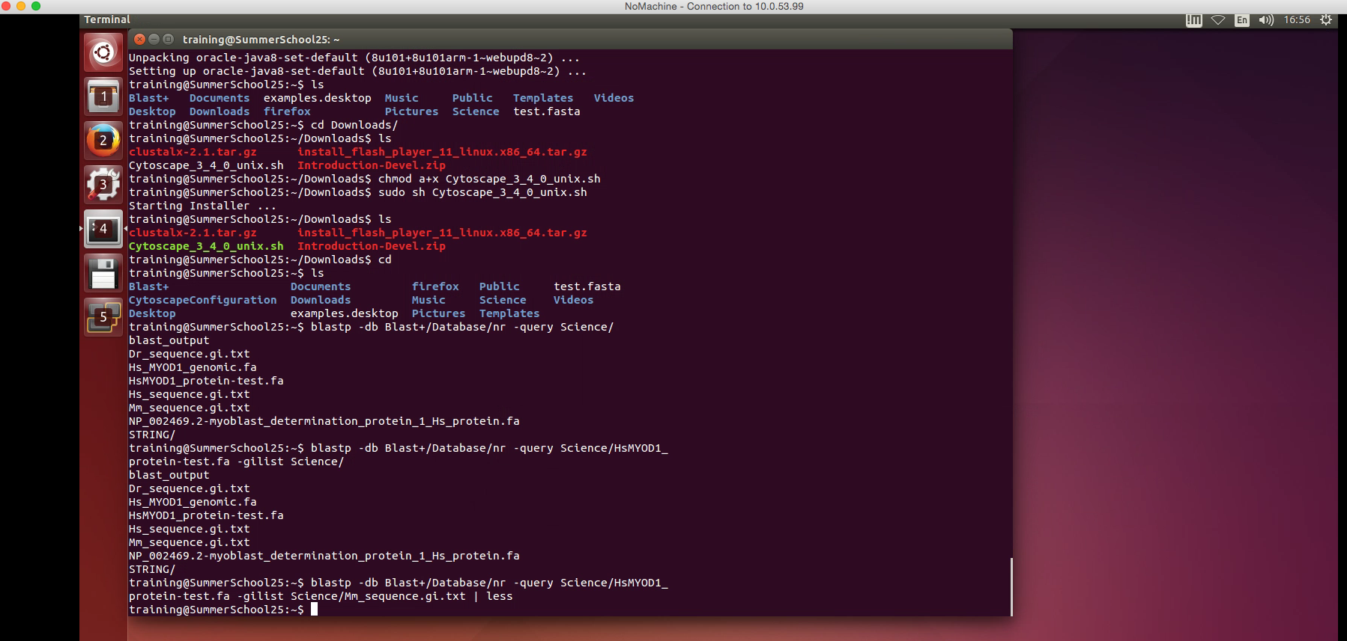
Open terminal

Slide 10
The Terminal: History and why
When Unix was developed in the '80s, computers did not have graphical interfaces
Back then computer were mostly used for data analysis.

Slide 11
The Terminal: why use it today?
A common problem in bioinformatics is to deal with big collections of text files
The terminal is a good instrument to manage big collections of text files. More than 30 years of experience.

Slide 12
Command Line
Useful commands:
ls: list files in current directory
mkdir: make a directory
cp: copy
rm: remove
cd: change directory
man [command]: load manual for optional command parameters
Can also get help from the internet!

Slide 13
Command Line Familiarity Exercises

Slide 14
Command Line Exercises (refresh!)
Creating directories
Removing whole directories
Creating text files
Removing files
Moving files from one directory to another
Copying files from one directory to another
Copying the files required for the Mini-Project using wildcard
Notes:
Get them to play around with
Creating directories
Creating files (nano) – make them create a Readme file which we can introduce the mini project
Moving the files from one directory to another
Copying files from one directory to another
Removing files
Removing whole directories
Looking at manuals

Slide 15
Creating directories
Create one directory with three directories inside of it all with names of your choosing
mkdir [mymainfolder]
cd [mymainfolder]
mkdir [myfolder1]
mkdir [myfolder2]
mkdir [myfolder3]
mkdir [myfolder1] [myfolder2] [myfolder3]

Slide 16
Removing whole directories
Remove (delete) one of the three sub-directories you just created
Note: If this directory had files in them then they would also be deleted
Remember, you can ‘tab’ complete a file/folder name (saves you typing the whole name!) or ‘double tab’ to view all files in folder
cd [mymainfolder]
rm –r [myfolder3]
-r option: Attempt to remove the file hierarchy rooted in each file argument.
type man rm to see other options
Note: if we type man in front of any command e.g. man mkdir then we can see all the options available for that command

Slide 17
Creating text files
Few text editors in the command line e.g. vi (vim) and nano
nano is simpler to use

Slide 18
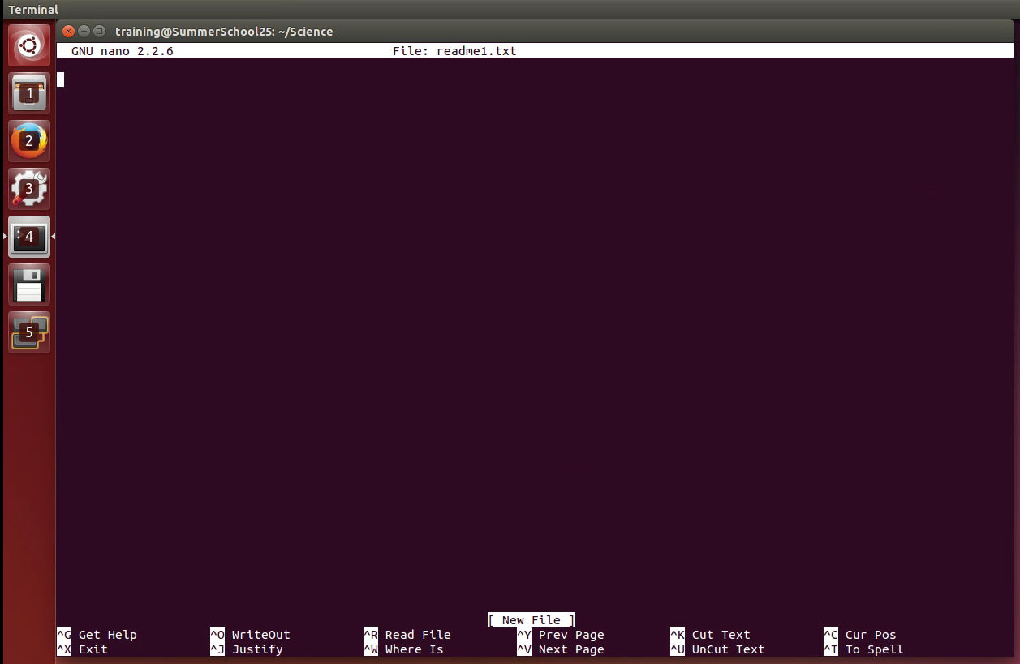
Creating text files
Change directory to one of your two created sub-directories
nano readme1.txt >
Type anything
ctrl + o > enter
ctrl + x > exit
Create another file called readme2.txt with random contents

Slide 19
Copying files
Copy readme2.txt file to one of your other subdirectories
cp readme2.txt ../[myfolder2]

Slide 20
Moving files
Move the readme2.txt file in your working directory to the main folder (up one level)
mv readme2.txt ../

Slide 21
Removing files
Delete the copied readme2.txt file in your other subdirectory
rm [myfolder2]/readme2.txt

Slide 22
Mini-Project: Biological Problem Hunt
Good practice to create notes of command line steps
This can include your terminal scripts
You can make notes in your Readme file (the one that should be in the [mymainfolder] you created)
Maybe make notes from now on …..

Slide 23

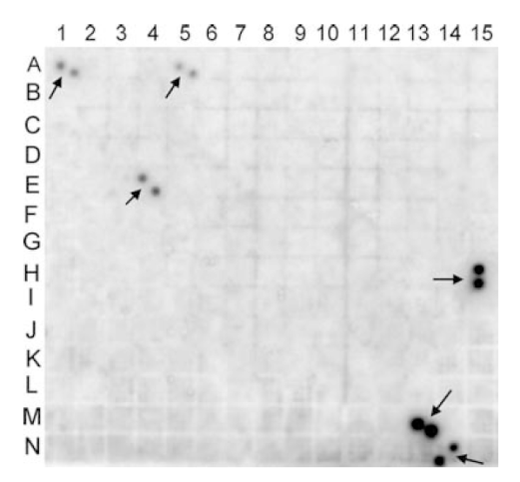
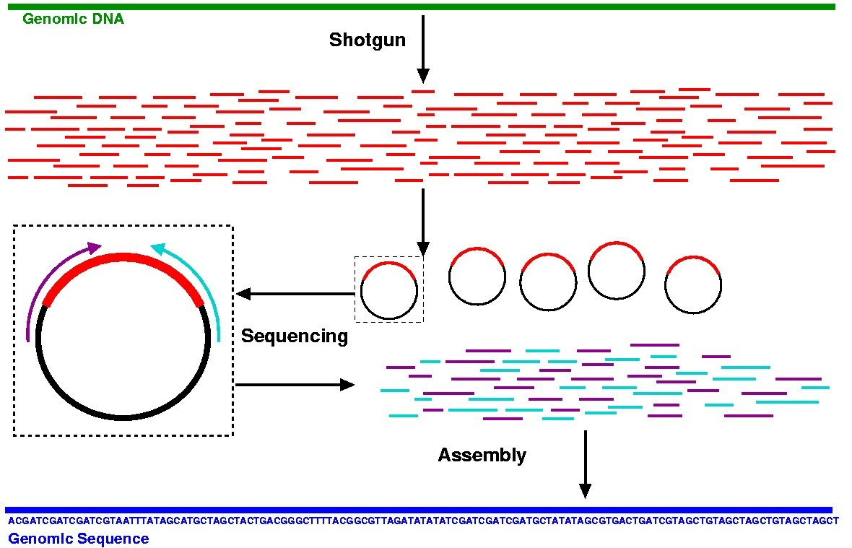
Mini-Project: Biological Problem Hunt
Organism of interest
Extract
Probe BAC libraries using a known gene of interest
Sequence positive clones
Shotgun approach
Assemble fragments into contigs

Slide 24
Mini-Project: Biological Problem Hunt
Organism of interest
Determine protein-coding regions
Annotate genes
Study protein-coding sequence
Identify non-coding regions
Notes:
We have sequenced fragment of DNA and assembled into a small contig. We now want to know what is in the contig. We turn to BLAST.

Slide 25
Mini-Project: Preparatory steps
Change to [mymainfolder] directory
Now we will copy the files we need for the mini-project
Notes:
Get them to copy relevant files – wildcards etc.
In their directory will be:
Hs_genomic_fragment.fa
Hs_sequence.gi.txt
Dr_sequence.gi.txt
Mm_sequence.gi.txt

Slide 26
Mini-Project: Preparatory steps
Copy ‘Hs_genomic_fragment.fa’ file from Science folder in ‘Home’ directory (Clue: ~/Science) to your current directory [mymainfolder]
You can define/point to copy to your current working directory by using ‘.’ at the end:
cp [file location]/[filename] .
Notes:
Get them to copy relevant files – wildcards etc.
In their directory will be:
Hs_genomic_fragment.fa
Hs_sequence.gi.txt
Dr_sequence.gi.txt
Mm_sequence.gi.txt

Slide 27
Mini-Project: Preparatory steps
Copy several similarly named files using a wildcard.
We have three files in the ~/Science folder with a similar name:
Hs_sequence.gi.txt
Dr_sequence.gi.txt
Mm_sequence.gi.txt
We can copy all three to our working directory using the wildcard ‘*’ command in one of several ways (here are a few options):
cp ~/Science/*_sequence.gi.txt .
OR
cp ~/Science/*.gi.txt .
OR
cp ~/Science/*i.txt .
Notes:
Get them to copy relevant files – wildcards etc.
In their directory will be:
Hs_genomic_fragment.fa
Hs_sequence.gi.txt
Dr_sequence.gi.txt
Mm_sequence.gi.txt

Slide 28
BREAK

Slide 29
Mini-Project: Biological Problem Hunt
Organism of interest
?

Slide 30
Mini-Project summary
XX
XX
XX

Slide 31
Mini-Project: Part 1
Command line BLAST manual found here: http://www.ncbi.nlm.nih.gov/books/NBK279690/pdf/Bookshelf_NBK279690.pdf
Get them to view BLAST options
E.g. blastx –help
gilist intro
Notes:
Go with MYOD1
http://www.ncbi.nlm.nih.gov/gene/4654
3 exons – 1726nt, 320aa
Extracted nucleotide sequence (UCSC/Ensembl) - Hs_genomic_fragment.fa
provide them with this > blastx (translate nt to protein – nr database): blastx -db Blast+/Database/nr -query Science/Hs_genomic_fragment.fa -gilist Science/sequence.gi.txt [this is human specific for quickness, explain!]
View blast output, what is top hit? Go online and find function of gene > record in readme file
extract myod1 homo protein (should be 100% match)
blastdbcmd -db Blast+/Database/nr -entry NP_002469.2 [or can us gi number] > Science/NP_002469.2-myoblast_determination_protein_1_Hs_protein.fa [explain everything]
At this point also show how to obtain uniprot information of the protein from command line [need to look online for this]
Also show tblastn (BLAST-2-Sequences) – protein against nt (align two) > now from this can someone see how many exons there are?
tblastn -query NP_002469.2-myoblast_determination_protein_1_Hs_protein.fa -subject Hs_genomic_fragment.fa
Do blastp on nr, pull out orthologs of mouse and zebrafish
blastp -db Blast+/Database/nr -query Science/HsMYOD1_protein-test.fa -gilist Science/Mm_sequence.gi.txt
blastp -db Blast+/Database/nr -query Science/HsMYOD1_protein-test.fa -gilist Science/Dr_sequence.gi.txt

Slide 32
Mini-Project summary
Find protein in NR database
Retrieve protein sequence
Align genomic sequence to protein sequence
Find orthologs in other vertebrates
Notes:
32

Slide 33
I/O redirection
In Unix, programs have three default files open: stdout, stderr and stdin.
These are usually connected to the screen (terminal) and keyboard, but we can redirect them to other files.
Notes:
Go with MYOD1
http://www.ncbi.nlm.nih.gov/gene/4654
3 exons – 1726nt, 320aa
Extracted nucleotide sequence (UCSC/Ensembl) - Hs_genomic_fragment.fa
provide them with this > blastx (translate nt to protein – nr database): blastx -db Blast+/Database/nr -query Science/Hs_genomic_fragment.fa -gilist Science/sequence.gi.txt [this is human specific for quickness, explain!]
View blast output, what is top hit? Go online and find function of gene > record in readme file
extract myod1 homo protein (should be 100% match)
blastdbcmd -db Blast+/Database/nr -entry NP_002469.2 [or can us gi number] > Science/NP_002469.2-myoblast_determination_protein_1_Hs_protein.fa [explain everything]
At this point also show how to obtain uniprot information of the protein from command line [need to look online for this]
Also show tblastn (BLAST-2-Sequences) – protein against nt (align two) > now from this can someone see how many exons there are?
tblastn -query NP_002469.2-myoblast_determination_protein_1_Hs_protein.fa -subject Hs_genomic_fragment.fa
Do blastp on nr, pull out orthologs of mouse and zebrafish
blastp -db Blast+/Database/nr -query Science/HsMYOD1_protein-test.fa -gilist Science/Mm_sequence.gi.txt
blastp -db Blast+/Database/nr -query Science/HsMYOD1_protein-test.fa -gilist Science/Dr_sequence.gi.txt
33

Slide 34
I/O redirection
Redirecting standard output:
echo “hello, world.” > hello.txt
Here we redirect standard output into a file called hello.txt
The file will be created if it does not exist.
The file will be overwritten if it does exist.
Notes:
Go with MYOD1
http://www.ncbi.nlm.nih.gov/gene/4654
3 exons – 1726nt, 320aa
Extracted nucleotide sequence (UCSC/Ensembl) - Hs_genomic_fragment.fa
provide them with this > blastx (translate nt to protein – nr database): blastx -db Blast+/Database/nr -query Science/Hs_genomic_fragment.fa -gilist Science/sequence.gi.txt [this is human specific for quickness, explain!]
View blast output, what is top hit? Go online and find function of gene > record in readme file
extract myod1 homo protein (should be 100% match)
blastdbcmd -db Blast+/Database/nr -entry NP_002469.2 [or can us gi number] > Science/NP_002469.2-myoblast_determination_protein_1_Hs_protein.fa [explain everything]
At this point also show how to obtain uniprot information of the protein from command line [need to look online for this]
Also show tblastn (BLAST-2-Sequences) – protein against nt (align two) > now from this can someone see how many exons there are?
tblastn -query NP_002469.2-myoblast_determination_protein_1_Hs_protein.fa -subject Hs_genomic_fragment.fa
Do blastp on nr, pull out orthologs of mouse and zebrafish
blastp -db Blast+/Database/nr -query Science/HsMYOD1_protein-test.fa -gilist Science/Mm_sequence.gi.txt
blastp -db Blast+/Database/nr -query Science/HsMYOD1_protein-test.fa -gilist Science/Dr_sequence.gi.txt
34

Slide 35
I/O redirection
Redirecting standard input:
tr “.” “!” < hello.txt
Here we connect a file to standard input.
We can also redirect standard output:
tr “.” “!” < hello.txt > hello2.txt
Notes:
Go with MYOD1
http://www.ncbi.nlm.nih.gov/gene/4654
3 exons – 1726nt, 320aa
Extracted nucleotide sequence (UCSC/Ensembl) - Hs_genomic_fragment.fa
provide them with this > blastx (translate nt to protein – nr database): blastx -db Blast+/Database/nr -query Science/Hs_genomic_fragment.fa -gilist Science/sequence.gi.txt [this is human specific for quickness, explain!]
View blast output, what is top hit? Go online and find function of gene > record in readme file
extract myod1 homo protein (should be 100% match)
blastdbcmd -db Blast+/Database/nr -entry NP_002469.2 [or can us gi number] > Science/NP_002469.2-myoblast_determination_protein_1_Hs_protein.fa [explain everything]
At this point also show how to obtain uniprot information of the protein from command line [need to look online for this]
Also show tblastn (BLAST-2-Sequences) – protein against nt (align two) > now from this can someone see how many exons there are?
tblastn -query NP_002469.2-myoblast_determination_protein_1_Hs_protein.fa -subject Hs_genomic_fragment.fa
Do blastp on nr, pull out orthologs of mouse and zebrafish
blastp -db Blast+/Database/nr -query Science/HsMYOD1_protein-test.fa -gilist Science/Mm_sequence.gi.txt
blastp -db Blast+/Database/nr -query Science/HsMYOD1_protein-test.fa -gilist Science/Dr_sequence.gi.txt
35

Slide 36
I/O redirection
Connecting standard output of one program to the standard input of another is called a pipe.
tr “.” “!” < hello.txt | less
Here we connect standard output of tr to the standard input of less.
Notes:
Go with MYOD1
http://www.ncbi.nlm.nih.gov/gene/4654
3 exons – 1726nt, 320aa
Extracted nucleotide sequence (UCSC/Ensembl) - Hs_genomic_fragment.fa
provide them with this > blastx (translate nt to protein – nr database): blastx -db Blast+/Database/nr -query Science/Hs_genomic_fragment.fa -gilist Science/sequence.gi.txt [this is human specific for quickness, explain!]
View blast output, what is top hit? Go online and find function of gene > record in readme file
extract myod1 homo protein (should be 100% match)
blastdbcmd -db Blast+/Database/nr -entry NP_002469.2 [or can us gi number] > Science/NP_002469.2-myoblast_determination_protein_1_Hs_protein.fa [explain everything]
At this point also show how to obtain uniprot information of the protein from command line [need to look online for this]
Also show tblastn (BLAST-2-Sequences) – protein against nt (align two) > now from this can someone see how many exons there are?
tblastn -query NP_002469.2-myoblast_determination_protein_1_Hs_protein.fa -subject Hs_genomic_fragment.fa
Do blastp on nr, pull out orthologs of mouse and zebrafish
blastp -db Blast+/Database/nr -query Science/HsMYOD1_protein-test.fa -gilist Science/Mm_sequence.gi.txt
blastp -db Blast+/Database/nr -query Science/HsMYOD1_protein-test.fa -gilist Science/Dr_sequence.gi.txt
36

Slide 37
I/O redirection
It is possible to form long pipelines:
ls -1 ~/Science | grep gi.txt | less
Here we connect the output of ls to grep, perform a search, and output the results to less.
Notes:
Go with MYOD1
http://www.ncbi.nlm.nih.gov/gene/4654
3 exons – 1726nt, 320aa
Extracted nucleotide sequence (UCSC/Ensembl) - Hs_genomic_fragment.fa
provide them with this > blastx (translate nt to protein – nr database): blastx -db Blast+/Database/nr -query Science/Hs_genomic_fragment.fa -gilist Science/sequence.gi.txt [this is human specific for quickness, explain!]
View blast output, what is top hit? Go online and find function of gene > record in readme file
extract myod1 homo protein (should be 100% match)
blastdbcmd -db Blast+/Database/nr -entry NP_002469.2 [or can us gi number] > Science/NP_002469.2-myoblast_determination_protein_1_Hs_protein.fa [explain everything]
At this point also show how to obtain uniprot information of the protein from command line [need to look online for this]
Also show tblastn (BLAST-2-Sequences) – protein against nt (align two) > now from this can someone see how many exons there are?
tblastn -query NP_002469.2-myoblast_determination_protein_1_Hs_protein.fa -subject Hs_genomic_fragment.fa
Do blastp on nr, pull out orthologs of mouse and zebrafish
blastp -db Blast+/Database/nr -query Science/HsMYOD1_protein-test.fa -gilist Science/Mm_sequence.gi.txt
blastp -db Blast+/Database/nr -query Science/HsMYOD1_protein-test.fa -gilist Science/Dr_sequence.gi.txt
37

Slide 38
Command-line blast
Let's search the nr protein database for our genomic sequence translated in six reading frames:
blastx
-db ~/Blast+/Database/nr
-query Hs_genomic_fragment.fa
-gilist sequence.gi.txt
| less
We view the results in less to quickly check that we get something sensible.
Notes:
Go with MYOD1
http://www.ncbi.nlm.nih.gov/gene/4654
3 exons – 1726nt, 320aa
Extracted nucleotide sequence (UCSC/Ensembl) - Hs_genomic_fragment.fa
provide them with this > blastx (translate nt to protein – nr database): blastx -db Blast+/Database/nr -query Science/Hs_genomic_fragment.fa -gilist Science/sequence.gi.txt [this is human specific for quickness, explain!]
View blast output, what is top hit? Go online and find function of gene > record in readme file
extract myod1 homo protein (should be 100% match)
blastdbcmd -db Blast+/Database/nr -entry NP_002469.2 [or can us gi number] > Science/NP_002469.2-myoblast_determination_protein_1_Hs_protein.fa [explain everything]
At this point also show how to obtain uniprot information of the protein from command line [need to look online for this]
Also show tblastn (BLAST-2-Sequences) – protein against nt (align two) > now from this can someone see how many exons there are?
tblastn -query NP_002469.2-myoblast_determination_protein_1_Hs_protein.fa -subject Hs_genomic_fragment.fa
Do blastp on nr, pull out orthologs of mouse and zebrafish
blastp -db Blast+/Database/nr -query Science/HsMYOD1_protein-test.fa -gilist Science/Mm_sequence.gi.txt
blastp -db Blast+/Database/nr -query Science/HsMYOD1_protein-test.fa -gilist Science/Dr_sequence.gi.txt
38

Slide 39
Command-line blast
Now let's output it in a more machine-readable format and write it to a file:
blastx
-outfmt 6
-db ~/Blast+/Database/nr
-query Hs_genomic_fragment.fa
-gilist sequence.gi.txt
> blast_results
Have a look at the output file with less. It is a tab-delimited format.
Notes:
Go with MYOD1
http://www.ncbi.nlm.nih.gov/gene/4654
3 exons – 1726nt, 320aa
Extracted nucleotide sequence (UCSC/Ensembl) - Hs_genomic_fragment.fa
provide them with this > blastx (translate nt to protein – nr database): blastx -db Blast+/Database/nr -query Science/Hs_genomic_fragment.fa -gilist Science/sequence.gi.txt [this is human specific for quickness, explain!]
View blast output, what is top hit? Go online and find function of gene > record in readme file
extract myod1 homo protein (should be 100% match)
blastdbcmd -db Blast+/Database/nr -entry NP_002469.2 [or can us gi number] > Science/NP_002469.2-myoblast_determination_protein_1_Hs_protein.fa [explain everything]
At this point also show how to obtain uniprot information of the protein from command line [need to look online for this]
Also show tblastn (BLAST-2-Sequences) – protein against nt (align two) > now from this can someone see how many exons there are?
tblastn -query NP_002469.2-myoblast_determination_protein_1_Hs_protein.fa -subject Hs_genomic_fragment.fa
Do blastp on nr, pull out orthologs of mouse and zebrafish
blastp -db Blast+/Database/nr -query Science/HsMYOD1_protein-test.fa -gilist Science/Mm_sequence.gi.txt
blastp -db Blast+/Database/nr -query Science/HsMYOD1_protein-test.fa -gilist Science/Dr_sequence.gi.txt
39

Slide 40
Command-line blast
We can extract the sequence for the top hit into a protein FASTA file:
blastdbcmd
-db ~/Blast+/Database/nr
-entry NP_002469.2
> protein.fasta
Notes:
Go with MYOD1
http://www.ncbi.nlm.nih.gov/gene/4654
3 exons – 1726nt, 320aa
Extracted nucleotide sequence (UCSC/Ensembl) - Hs_genomic_fragment.fa
provide them with this > blastx (translate nt to protein – nr database): blastx -db Blast+/Database/nr -query Science/Hs_genomic_fragment.fa -gilist Science/sequence.gi.txt [this is human specific for quickness, explain!]
View blast output, what is top hit? Go online and find function of gene > record in readme file
extract myod1 homo protein (should be 100% match)
blastdbcmd -db Blast+/Database/nr -entry NP_002469.2 [or can us gi number] > Science/NP_002469.2-myoblast_determination_protein_1_Hs_protein.fa [explain everything]
At this point also show how to obtain uniprot information of the protein from command line [need to look online for this]
Also show tblastn (BLAST-2-Sequences) – protein against nt (align two) > now from this can someone see how many exons there are?
tblastn -query NP_002469.2-myoblast_determination_protein_1_Hs_protein.fa -subject Hs_genomic_fragment.fa
Do blastp on nr, pull out orthologs of mouse and zebrafish
blastp -db Blast+/Database/nr -query Science/HsMYOD1_protein-test.fa -gilist Science/Mm_sequence.gi.txt
blastp -db Blast+/Database/nr -query Science/HsMYOD1_protein-test.fa -gilist Science/Dr_sequence.gi.txt
40

Slide 41
Command-line blast
We can extract the sequence for the top hit into a protein FASTA file:
blastdbcmd
-db ~/Blast+/Database/nr
-entry NP_002469.2
> protein.fasta
Notes:
Go with MYOD1
http://www.ncbi.nlm.nih.gov/gene/4654
3 exons – 1726nt, 320aa
Extracted nucleotide sequence (UCSC/Ensembl) - Hs_genomic_fragment.fa
provide them with this > blastx (translate nt to protein – nr database): blastx -db Blast+/Database/nr -query Science/Hs_genomic_fragment.fa -gilist Science/sequence.gi.txt [this is human specific for quickness, explain!]
View blast output, what is top hit? Go online and find function of gene > record in readme file
extract myod1 homo protein (should be 100% match)
blastdbcmd -db Blast+/Database/nr -entry NP_002469.2 [or can us gi number] > Science/NP_002469.2-myoblast_determination_protein_1_Hs_protein.fa [explain everything]
At this point also show how to obtain uniprot information of the protein from command line [need to look online for this]
Also show tblastn (BLAST-2-Sequences) – protein against nt (align two) > now from this can someone see how many exons there are?
tblastn -query NP_002469.2-myoblast_determination_protein_1_Hs_protein.fa -subject Hs_genomic_fragment.fa
Do blastp on nr, pull out orthologs of mouse and zebrafish
blastp -db Blast+/Database/nr -query Science/HsMYOD1_protein-test.fa -gilist Science/Mm_sequence.gi.txt
blastp -db Blast+/Database/nr -query Science/HsMYOD1_protein-test.fa -gilist Science/Dr_sequence.gi.txt
41

Slide 42
Command-line blast
Now we can search for that protein in other organisms:
blastp
-db ~/Blast+/Database/nr
-query protein.fasta
-gilist Mm_sequence.gi.txt
| less
Notes:
Go with MYOD1
http://www.ncbi.nlm.nih.gov/gene/4654
3 exons – 1726nt, 320aa
Extracted nucleotide sequence (UCSC/Ensembl) - Hs_genomic_fragment.fa
provide them with this > blastx (translate nt to protein – nr database): blastx -db Blast+/Database/nr -query Science/Hs_genomic_fragment.fa -gilist Science/sequence.gi.txt [this is human specific for quickness, explain!]
View blast output, what is top hit? Go online and find function of gene > record in readme file
extract myod1 homo protein (should be 100% match)
blastdbcmd -db Blast+/Database/nr -entry NP_002469.2 [or can us gi number] > Science/NP_002469.2-myoblast_determination_protein_1_Hs_protein.fa [explain everything]
At this point also show how to obtain uniprot information of the protein from command line [need to look online for this]
Also show tblastn (BLAST-2-Sequences) – protein against nt (align two) > now from this can someone see how many exons there are?
tblastn -query NP_002469.2-myoblast_determination_protein_1_Hs_protein.fa -subject Hs_genomic_fragment.fa
Do blastp on nr, pull out orthologs of mouse and zebrafish
blastp -db Blast+/Database/nr -query Science/HsMYOD1_protein-test.fa -gilist Science/Mm_sequence.gi.txt
blastp -db Blast+/Database/nr -query Science/HsMYOD1_protein-test.fa -gilist Science/Dr_sequence.gi.txt
42

Slide 43
awk
awk is a powerful text processing tool.
It can be used to filter reformat a text file very easily:
awk '$3 > 98 {print $2;}' blast_output
Here we filter using column 3, and print out column 2.
Be sure to use single quotes to stop bash interpreting the $ symbols.
Notes:
Go with MYOD1
http://www.ncbi.nlm.nih.gov/gene/4654
3 exons – 1726nt, 320aa
Extracted nucleotide sequence (UCSC/Ensembl) - Hs_genomic_fragment.fa
provide them with this > blastx (translate nt to protein – nr database): blastx -db Blast+/Database/nr -query Science/Hs_genomic_fragment.fa -gilist Science/sequence.gi.txt [this is human specific for quickness, explain!]
View blast output, what is top hit? Go online and find function of gene > record in readme file
extract myod1 homo protein (should be 100% match)
blastdbcmd -db Blast+/Database/nr -entry NP_002469.2 [or can us gi number] > Science/NP_002469.2-myoblast_determination_protein_1_Hs_protein.fa [explain everything]
At this point also show how to obtain uniprot information of the protein from command line [need to look online for this]
Also show tblastn (BLAST-2-Sequences) – protein against nt (align two) > now from this can someone see how many exons there are?
tblastn -query NP_002469.2-myoblast_determination_protein_1_Hs_protein.fa -subject Hs_genomic_fragment.fa
Do blastp on nr, pull out orthologs of mouse and zebrafish
blastp -db Blast+/Database/nr -query Science/HsMYOD1_protein-test.fa -gilist Science/Mm_sequence.gi.txt
blastp -db Blast+/Database/nr -query Science/HsMYOD1_protein-test.fa -gilist Science/Dr_sequence.gi.txt
43

Slide 44
Bash programming
Bash contains powerful programming features.
We can set and use variables:
str="Hello World!"
echo ${str}
Notes:
Go with MYOD1
http://www.ncbi.nlm.nih.gov/gene/4654
3 exons – 1726nt, 320aa
Extracted nucleotide sequence (UCSC/Ensembl) - Hs_genomic_fragment.fa
provide them with this > blastx (translate nt to protein – nr database): blastx -db Blast+/Database/nr -query Science/Hs_genomic_fragment.fa -gilist Science/sequence.gi.txt [this is human specific for quickness, explain!]
View blast output, what is top hit? Go online and find function of gene > record in readme file
extract myod1 homo protein (should be 100% match)
blastdbcmd -db Blast+/Database/nr -entry NP_002469.2 [or can us gi number] > Science/NP_002469.2-myoblast_determination_protein_1_Hs_protein.fa [explain everything]
At this point also show how to obtain uniprot information of the protein from command line [need to look online for this]
Also show tblastn (BLAST-2-Sequences) – protein against nt (align two) > now from this can someone see how many exons there are?
tblastn -query NP_002469.2-myoblast_determination_protein_1_Hs_protein.fa -subject Hs_genomic_fragment.fa
Do blastp on nr, pull out orthologs of mouse and zebrafish
blastp -db Blast+/Database/nr -query Science/HsMYOD1_protein-test.fa -gilist Science/Mm_sequence.gi.txt
blastp -db Blast+/Database/nr -query Science/HsMYOD1_protein-test.fa -gilist Science/Dr_sequence.gi.txt
44

Slide 45
Bash programming
Loops are used to perform repetitive or iterative tasks:
for file in *.gi.txt; do
echo "${file}";
wc -l ${file};
wc -c ${file};
done
We perform the tasks inside the loop for each file that matches *.gi.txt.
Notes:
Go with MYOD1
http://www.ncbi.nlm.nih.gov/gene/4654
3 exons – 1726nt, 320aa
Extracted nucleotide sequence (UCSC/Ensembl) - Hs_genomic_fragment.fa
provide them with this > blastx (translate nt to protein – nr database): blastx -db Blast+/Database/nr -query Science/Hs_genomic_fragment.fa -gilist Science/sequence.gi.txt [this is human specific for quickness, explain!]
View blast output, what is top hit? Go online and find function of gene > record in readme file
extract myod1 homo protein (should be 100% match)
blastdbcmd -db Blast+/Database/nr -entry NP_002469.2 [or can us gi number] > Science/NP_002469.2-myoblast_determination_protein_1_Hs_protein.fa [explain everything]
At this point also show how to obtain uniprot information of the protein from command line [need to look online for this]
Also show tblastn (BLAST-2-Sequences) – protein against nt (align two) > now from this can someone see how many exons there are?
tblastn -query NP_002469.2-myoblast_determination_protein_1_Hs_protein.fa -subject Hs_genomic_fragment.fa
Do blastp on nr, pull out orthologs of mouse and zebrafish
blastp -db Blast+/Database/nr -query Science/HsMYOD1_protein-test.fa -gilist Science/Mm_sequence.gi.txt
blastp -db Blast+/Database/nr -query Science/HsMYOD1_protein-test.fa -gilist Science/Dr_sequence.gi.txt
45

Slide 46
Mini-Project: Part 2 – Studying the protein-protein interactions of MYOD1

Slide 47
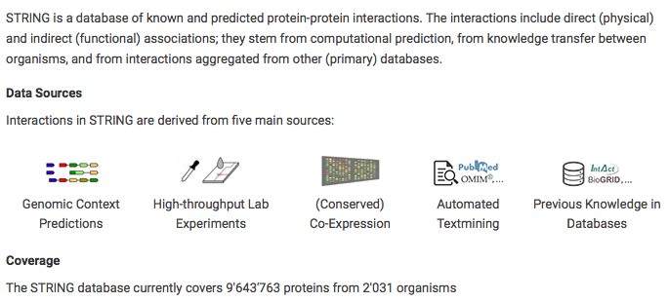
Mini-Project: Part 2a - STRING
Pre-downloaded protein-protein interactions from STRING database (http://string-db.org/)

Slide 48
Mini-Project: Part 2a - STRING
Of the several organisms, we downloaded those of Human, Mouse and Zebrafish
These have been pre-downloaded located in the ~/Science/STRING folder
Possible to download yourself on command line: wget [hyperlink]
wget http://string-db.org/download/protein.links.v10/9606.protein.links.v10.txt.gz
Notes:
STRING human 9606 (47 Mb) @ http://string-db.org/download/protein.links.v10/9606.protein.links.v10.txt.gz
STRING mouse 10090 (53.9 Mb) @ http://string-db.org/download/protein.links.v10/10090.protein.links.v10.txt.gz
STRING zebrafish 7955 (87.4 Mb) @ http://string-db.org/download/protein.links.v10/7955.protein.links.v10.txt.gz
Unzip files

Slide 49
Mini-Project: Part 2a - STRING
Everything in STRING database according to Ensembl IDs
Can map Ensembl IDs to gene symbols/genbank IDs using Biomart (online or R-script):
Online: http://www.ensembl.org/biomart/martview/fed1c6d531acfd2f170be64970110952
R-script package: https://bioconductor.org/packages/release/bioc/html/biomaRt.html

Slide 50
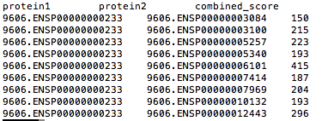
Mini-Project: Part 2b – STRING output
First protein
Second protein
Combined Score:
Known and predicted associations are scored and integrated to provide a combined score
Relative measure of the evidence supporting the interaction/association of the corresponding protein pair
Pair of interacting/associated proteins

Slide 51
Mini-Project: Part 2a – STRING output
Since we won’t be mapping we can obtain Ensembl IDs from the Ensembl website (Human): http://www.ensembl.org/Homo_sapiens/Info/Index

Slide 52
Mini-Project: Part 2b - Ensembl
Get the Ensembl IDs for Myod1:
Ensembl website for Homo sapiens: http://www.ensembl.org/Homo_sapiens/Info/Index
Search for ‘MYOD1’ - ENSG00000129152
Click on gene in browser to reveal protein ID ENSP00000250003
Go to orthologues to find Dr (ENSDARG00000030110/ENSDARP00000009713) and Mm (ENSMUSG00000009471/ENSMUSP00000072330)

Slide 53
Mini-Project: Part 2c – Grep MYOD1 interactions/associations
Select all protein-protein interactions/associations of MYOD1 from STRING txt files using grep command:
Go to Terminal
Change to your working directory [mymainfolder]
man grep
Options like -i, -w, and -F are good for searching for a specific pattern e.g. paralogous genes like hox1a, hox1, hox1b. Usage: grep -wiF [pattern]
As our protein IDs are very specific we can grep directly:
grep ENSP00000250003 ~/Science/STRING/Hs_9606.protein.links.v10_delimit.txt > Hs_myod1_STRING.txt
Notes:
Converted to tab delimited file:
tr ' ' '\t’ < STRING/Hs_9606.protein.links.v10.txt > STRING/Hs_9606.protein.links.v10_delimit.txt
for file in STRING/*.v10.txt ; do cat "$file" | tr ' ' '\t' > STRING/"$(basename "$file" .txt)_delimit.txt" ; done
Dr_7955.protein.links.v10_delimit.txt
Hs_9606.protein.links.v10_delimit.txt
Mm_10090.protein.links.v10_delimit.txt
Grep out all protein-protein interactions for Hs, Mm and Dr from STRING txt files

Slide 54
Mini-Project: Part 2c - Grep MYOD1 interactions/associations
Grep out all protein-protein interactions/associations of MYOD1 from other organisms
Mouse (Mm)
Zebrafish (Dr)
Mouse
grep ENSMUSP00000072330 ~/Science/STRING/Mm_10090.protein.links.v10_delimit.txt > Mm_myod1_STRING.txt
Zebrafish
grep ENSDARP00000009713 ~/Science/STRING/Dr_7955.protein.links.v10_delimit.txt > Dr_myod1_STRING.txt
Notes:
Dr_7955.protein.links.v10_delimit.txt
Mm_10090.protein.links.v10_delimit.txt

Slide 55
Mini-Project: Part 2
Filter according to score - only keeping those with a 'combined_score’ (last column) ≥ 600
We do this to select those interactions/associations with higher confidence
Notes:
Filter according to score - only keeping those with a 'combined_score’ (last column) ≥ 600:
awk '(NR==1) || ($3 > 599 )’ Hs_9606.protein.links.v10_delimit.txt > Hs_9606.protein.links.v10_delimit_a.txt (can do separately for each file, explain) OR
for file in *_myod1_STRING.txt ; do awk '(NR==1) || ($3 > 599 )' "$file" > "$(basename "$file" .txt) _a.txt"; done (explain each part of this code – advanced)

Slide 56
Mini-Project: Part 2
We can do this with the awk command
Powerful command for pattern-directed scanning and processing language
man awk
For our filtering (just on one file):
awk '(NR==1) || ($3 > 599)’ Hs_myod1_STRING.txt > Hs_myod1_STRING-filtered.txt
We use the ‘quotation mark’ to enclose the required command for awk.
NR is for the number of records in the input file i.e. Number of Lines seen so far in the current file
We use ==1 to match from the first line and each corresponding line will go through to the next command
We use double pipe || to act as an OR command as opposed to an AND command
Notes:
Filter according to score - only keeping those with a 'combined_score’ (last column) ≥ 600:
awk '(NR==1) || ($3 > 599)’ Hs_myod1_STRING.txt > Hs_myod1_STRING-filtered.txt (can do separately for each file, explain) OR
for file in *_myod1_STRING.txt ; do awk '(NR==1) || ($3 > 599 )' "$file" > "$(basename "$file" .txt) -filtered.txt"; done (explain each part of this code – advanced)
Single quotes protect everything between the opening and closing quotes. The shell does no interpretation of the quoted text, passing it on verbatim to the command. It is impossible to embed a single quote inside single-quoted text. Refer back to Comments, for an example of what happens if you try.
Double quotes protect most things between the opening and closing quotes. The shell does at least variable and command substitution on the quoted text. Different shells may do additional kinds of processing on double-quoted text.

Slide 57
Mini-Project: Part 2
Can anyone run the same command on all files using one line?
Clue: for file in XX
Single File Command:
awk '(NR==1) || ($3 > 599)’ Hs_myod1_STRING.txt > Hs_myod1_STRING-filtered.txt
Multiple File Command:
for file in *_myod1_STRING.txt ; do awk '(NR==1) || ($3 > 599 )' "$file" > "$(basename "$file" .txt) -filtered.txt"; done

